Slide 1

SQL

Slide 2
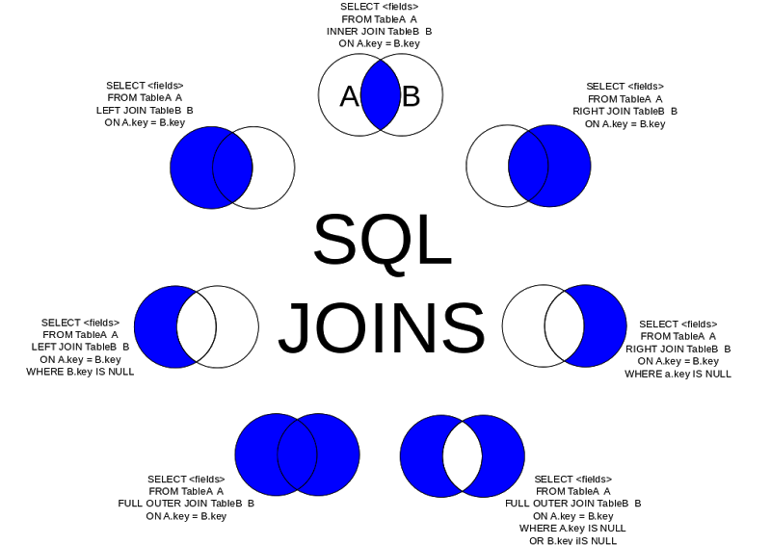

Slide 3
Spark SQL Joins:
Example take Sample datsets having passengers data
val conf = new SparkConf().setMaster("local").setAppName("Joins") val sc = new SparkContext(conf) val sqlContext = new SQLContext(sc) import sqlContext.implicits._ val passendersDF = sqlContext.read.format("com.databricks.spark.csv").option("inferSchema","true").option("header", "true").load("/user/cloudera/datasets/passengers.csv") val gensubDF = sqlContext.read.format("com.databricks.spark.csv").option("inferSchema","true").option("header", "true").load("/user/cloudera/datasets/gender_submission.csv") passendersDF.registerTempTable(“passengers") gensubDF.registerTempTable(“gensub")

Slide 4
Full Join
Full Join will give all columns from joining tables
Ex:
passendersDF.join(gensubDF).show
//or
sqlContext.sql("select * from passengers p join gensub g").show

Slide 5
Inner Join :
Inner join will give matched columns from table a and table B , on the basis of given column condition
passendersDF.join(gensubDF,passendersDF("PassengerId") === gensubDF("PassengerId"),"inner").show //or sqlContext.sql("select * from passengers p join gensub g on p.PassengerId = g.PassengerId").show

Slide 6
Left Join or Left Outer Join
Left join or left outer join will give all columns from left table and matching columns
from right table , on the basis of given column condition. Non matching columns from right
Table shown as null.
passendersDF.as(“p").join(gensubDF.as("g"),passendersDF("PassengerId") === gensubDF("PassengerId"),"left").show //or sqlContext.sql("select * from passengers p left join gensub g on p.PassengerId = g.PassengerId").show

Slide 7
Right or Right Outer Join
Right join or right outer join will give all columns from right table and matching columns
from left table , on the basis of given column condition. Non matching columns from left
Table shown as null.
passendersDF.as(“p").join(gensubDF.as("g"),passendersDF("PassengerId") === gensubDF("PassengerId"),"right").show //or sqlContext.sql("select * from passengers p right join gensub g on p.PassengerId = g.PassengerId").show

Slide 8
Where Clause :
Where clause is used to filer the data in Dataframes or Datasets.
passendersDF.as(“p").join(gensubDF.as("g"),passendersDF("PassengerId") === gensubDF("PassengerId"),"right").where("t.PassengerId is not null" ).show

Slide 9
Selecting columns
If we use map, then the result is a Dataset so the column types are inherited but the column names are lost.
If we use select and the column names, then the result is a DataFrame, so the type of the columns are lost.
If we use select and provide the column names AND the column types, then the result is a Dataset with seemingly proper column names and proper types.

Slide 10
Selecting columns
passendersDF.select(col("PassengerId"),col("Name"),col("Age"),col("Sex")).show() passendersDF.select("PassengerId","Name","Age","Sex").show() passendersDF.select(col = "PassengerId").show passendersDF.map(x => x.getAs[Int]("PassengerId")).toDF().show

Slide 11
Renaming columns
If we use withColumnRenamed then we can rename the columns one-by-one, the result is a DataFrame.
We can convert the Dataset to DataFrame and define all new column names in one step and the result is obviously a DataFrame.

Slide 12
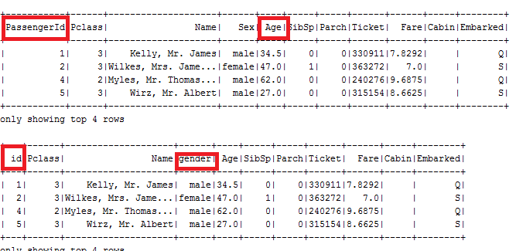
Renaming Columns
On the basis of your requirement you can rename the Dataframe Columns Allso
passendersDF.show(4) passendersDF.withColumnRenamed("PassengerId","id").withColumnRenamed("Sex","gender").show(4)

Slide 13
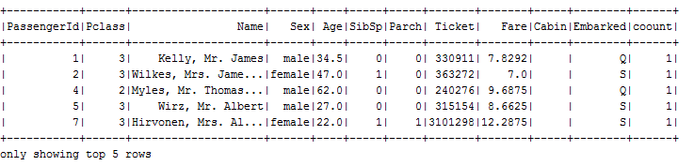
Adding new columns
constant value
Adding a constant column is easy. Use the withColumn function and provide the name of the new column and the lit() with the value inside the brackets
Ex: passendersDF.withColumn("coount",lit(1)).show(5)

Slide 14
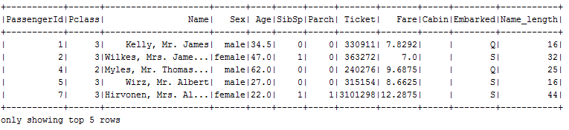
Adding new Column
Dynamic value
You can take the help of any sql function to add dynamic value for the new Column
EX;
passendersDF.withColumn("Name_length",length(passendersDF.col("Name"). as[String])).show(5)

Slide 15
UDF’s in Spark SQL :
Spark supports user defined functions , If spark functions are not satisfactory for
your requirements then we can write our functionality.
To write udfs we need to import the packages from org.apache.spark.sql.function._
case female passengers are eligible for 10% discount , this case we can write our
Own functionality for given case.

Slide 16
UDF’s Spark SQL
import org.apache.spark.sql.functions._ val getEligibility = (s :String) => s.equals("female") val eligibilityUdf = udf(getEligibility) passendersDF.select(passendersDF("Name"),eligibilityUdf(passendersDF("Sex"))).show
Note : if you want to use this temporary function in the queries also you need to register
this function with SQLContext or HiveContext

Slide 17
UDF’s Spark:
Registering udfs with SQLContext or HiveContext can help driver to use udfs in queries also
sqlContext.udf.register("checkeligibility",(s:String) => s.equals("female")) sqlContext.sql("select Name,checkeligibility(Sex) as eligibility from passengers").show(5)

Slide 18
Shared Variables

Slide 19
Shared Variables in Spark:
Spark contains two different types of shared variables − one is broadcast variables and second is accumulators
Broadcast variables − used to efficiently, distribute large values.
Accumulators − used to aggregate the information of particular collection.

Slide 20
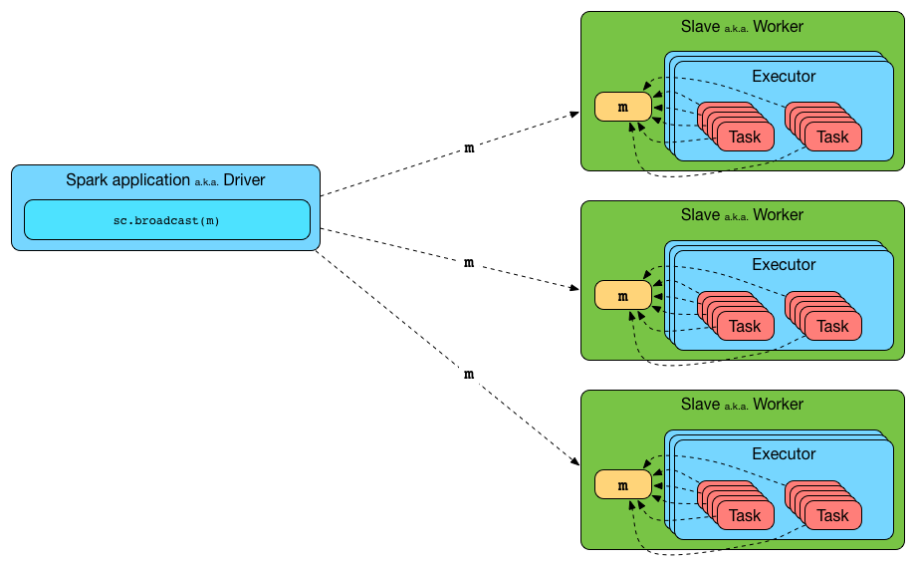
Broadcast Variables
Broadcast variables allow the programmer to keep a read-only variable cached on each machine rather than shipping a copy of it with tasks. They can be used. For example, to give every node, a copy of a large input dataset, in an efficient manner. Spark also attempts to distribute broadcast variables using efficient broadcast algorithms to reduce communication cost.

Slide 21
How to Create Broadcast Variables ?
Broadcast variables are created from a variable v by calling SparkContext.broadcast(v). The broadcast variable is a wrapper around v, and its value can be accessed by calling the value method. The code given below shows this −
scala> val broadcastVar = sc.broadcast(Array(1, 2, 3))
broadcastVar: org.apache.spark.broadcast.Broadcast[Array[Int]] = Broadcast(0)
scala> broadcastVar.value
res0: Array[Int] = Array(1, 2, 3)
After the broadcast variable is created, it should be used instead of the value v in any functions run on the cluster, so that v is not shipped to the nodes more than once. In addition, the object v should not be modified after its broadcast, in order to ensure that all nodes get the same value of the broadcast variable.

Slide 22
Example Broad Cast Variable :
case class Employee(name:String, age:Int, depId: String)
case class Department(id: String, name: String)
val employeesRDD = sc.parallelize(Seq(
Employee("Mary", 33, "IT"), Employee("Paul", 45, "IT"), Employee("Peter", 26, "MKT"),
Employee("Jon", 34, "MKT"),Employee("Sarah", 29, "IT"),Employee("Steve", 21, "Intern")
))
val departmentsRDD = sc.parallelize(Seq(
Department("IT", "IT Department"),Department("MKT", "Marketing Department"),
Department("FIN", "Finance & Controlling")
))
val employeesDF = employeesRDD.toDF
val departmentsDF = departmentsRDD.toDF
// The DataFrame API of Spark makes it very concise to create a broadcast variable out of the department DataFrame.
// materializing the department data
val tmpDepartments = broadcast(departmentsDF.as("departments"))
// join by employees.depID == departments.id
employeesDF.join(broadcast(tmpDepartments), $"depId" === $"id", "inner").show()

Slide 23
Case study Broadcast variables :
We are broadcasting us_states data so that every node will get same data for joining
Tables instead of shuffling data between nodes in the cluster.
See the below given code..
val localDF = sqlContext.read.json("/user/cloudera/datasets/us_states.json") val broadcastStateData = sqlContext.sparkContext.broadcast(localDF.collectAsList()) val broadcastSchema = sqlContext.sparkContext.broadcast(localDF.schema) // Create a DataFrame based on the store locations. val storesDF = sqlContext.read.json("/user/cloudera/datasets/store_locations.json") // Create a DataFrame of US state data with the broadcast variables. val stateDF = sqlContext.createDataFrame(broadcastStateData.value, broadcastSchema.value) // Join the DataFrames to get an aggregate count of stores in each US Region //"How many stores are in each US region?" val joinedDF = storesDF.join(stateDF, "state").groupBy("census_region").count() joinedDF.show()

Slide 24
What are Accumulators ?
We have seen data passed from driver program to cluster but have not seen the data from nodes back to driver that could be aggregated across the clusters.
Accumulators provides a simple syntax for aggregating values from worker nodes back
to the driver program.

Slide 25
Accumulators
Accumulators are variables that are only “added” to through an associative operation and can therefore, be efficiently supported in parallel. They can be used to implement counters (as in MapReduce) or sums. Spark natively supports accumulators of numeric types, and programmers can add support for new types. If accumulators are created with a name, they will be displayed in Spark’s UI.
An accumulator is created from an initial value v by callingSparkContext.accumulator(v). Tasks running on the cluster can then add to it using the add method or the += operator (in Scala and Python). However, they cannot read its value. Only the driver program can read the accumulator’s value, using its value method
when Spark ships this code to every executor the variables become local to that executor and its updated value is not relayed back to the driver.
To avoid this problem we need to make a variable an accumulator such that all the updates to this variable in every executor is relayed back to the driver.

Slide 26
WordCount with Accumulators:
val accum=sc.accumulator(0) sc.parallelize(Array(1,2,3,4)).foreach(x =>accum+= x)
Every time the word length will be added to accumulator shared by Spark driver
Program.
val accum=sc.accumulator(0) val wordcount = sc.textFile("/user/cloudera/datasets/CHANGES.txt").flatMap(_.split(" ")).foreach(W => accum += W.length) println(accum.value)

Slide 27
Accumulator Example
val conf = new SparkConf().setAppName("SparkAccumulatorBroadcastJoin") val sc = new SparkContext(conf) val purchaseInDelhi = sc.accumulator(0) val payRDD = sc.textFile("userInfo.csv") val payPair = payRDD.map(x => (x.split(",")(0),x)) val usrRDD = sc.textFile("payments.csv") val usrPair = usrRDD.map( x => { if(x.split(",")(1)=="Delhi") { purchaseInDelhi += 1 } (x.split(",")(0),x.split(",")(2)) } ) val usrMap = usrPair.collectAsMap() val r = payPair.map(v => (v._1,(usrMap(v._1),v._2))) r.foreach(println) r.saveAsTextFile("results") println("No of Delhi purchase " + purchaseInDelhi.value)

